Slide 1

Web3 based Social Media Platform using Blockchain
Submitted in the partial fulfillment for the award of
the degree of
BACHELOR OF ENGINEERING
IN
COMPUTER SCIENCE WITH SPECIALIZATION IN
ARTIFICIAL INTELLIGENCE AND MACHINE LEARNING
Submitted by:
Aniket Mittal (20BCS6819)
Saikat Das (20BCS6818)
Bipandeep Singh (20BCS6809)
Under the Supervision of:
Dr. Preet Kamal (E15857)

Slide 2
OUTLINE
Introduction to Project
Problem Formulation
Objectives of the work
Methodology Used
Results and Outputs
Conclusion
Future Scope
References

Slide 3
Scope of the Project
Security Measures
Platform Focus
Security is a paramount consideration within the project's scope. The implementation includes secure authentication with MetaMask, robust smart contracts written in Solidity, and adherence to best practices to safeguard user data.
The project aims to develop a Web 3.0-based social media platform, reimagining user interactions with an emphasis on decentralization and user empowerment.
Functionalities Included
The scope encompasses the development of features such as user authentication through MetaMask, decentralized data storage using Sanity.io, NFT integration for unique profile pictures, and a dynamic user interface built with Next JS and Tailwind CSS.
Global Accessibility
The platform is designed for global accessibility, with deployment on Vercel ensuring scalability and a reliable infrastructure for users around the world.

Slide 4
Planning To Implement
Week 4
Authentication Integration and Data Management
Week 2
Frontend Development
Week 5
NFT Integration and Deployment
Week 1
Week 3
Requirement Analysis
Smart Contract Development

Slide 5
Week 1 | Week 2 | Week 3 | Week 4 | Week 5
Requirement Analysis
Frontend Development
Smart Contract Development
Authentication Integration
Data Management
NFT Integration
Deployment

Slide 6
Problem Formulation
Centralization of Power: Traditional social media platforms are controlled by a few tech giants, influencing content distribution and monetization without giving users a voice.
Lack of Transparency: Decisions about content moderation or even account bans are often made behind closed doors, leaving users without recourse.
Exploitation of User Data: User’s personal information and content are often monetized without their consent or equitable compensation.
Vulnerability to Censorship: Centralized platforms have the power to unilaterally suppress specific viewpoints or entire accounts.

Slide 7
Preliminary Design of the project
Architectural Overview
Our Web3-based social media platform adopts a decentralized architecture, leveraging Next JS for the frontend, Solidity smart contracts for backend logic, MetaMask for Web3 authentication, Sanity.io for decentralized data storage, and Vercel for hosting. This architecture ensures a distributed and transparent ecosystem for user interactions.
Decentralized Data Model
Sanity.io is employed for decentralized data storage. User-generated content, including tweets and profile information, is structured in a modular and scalable manner, ensuring efficient retrieval and decentralized access.

Slide 8
Preliminary Design of the project
Authentication Flow
Users authenticate using MetaMask, a secure and widely adopted Web3 wallet. The authentication flow involves secure key exchanges, enhancing user privacy and ensuring a seamless login experience.
NFT Minting Process
Users have the ability to mint their personalized NFT profile pictures directly from their profiles. This process involves selecting or uploading an image, defining metadata, and executing a blockchain transaction to establish digital ownership.

Slide 9
METHODOLOGY
Phased Development
The project is divided into distinct phases, each contributing to the overall development process:
Requirements Analysis: In-depth exploration of user needs and project objectives.
Frontend Development: Implementation of the user interface using Next JS and Tailwind CSS.
Smart Contract Development: Creation of Solidity smart contracts governing platform functionalities.
Authentication Integration: Implementation of MetaMask for secure Web3 authentication.
Data Management Implementation: Utilization of Sanity.io and GROQ for decentralized data storage and retrieval.
NFT Integration: Integration of NFT technology for unique profile picture creation.
Deployment on Vercel: Hosting the platform on Vercel for scalability and global accessibility.
User Testing and Feedback: Iterative testing phases to gather user input and refine features.
Documentation and Knowledge Transfer: Comprehensive documentation for future maintenance and development.
Continuous Improvement: Ongoing adjustments based on user feedback, emerging technologies, and industry trends.

Slide 10
METHODOLOGY
Agile Development Approach
Our project follows an agile development approach, emphasizing iterative progress and flexibility. This methodology allows us to adapt to changing requirements and integrate user feedback seamlessly.
Collaboration Tools
Collaboration is facilitated through tools such as Git for version control, Visual Studio Code for development, and project management tools for efficient communication and coordination.
Continuous Improvement Strategies
The project is designed for continuous improvement, with mechanisms in place for Feedback Loops, Regularly gathering feedback from users to inform future updates and Agile Development Practices, Agile methodologies to quickly respond to changes and new requirements.

Slide 11
Analysis of Features
User Authentication Flow
Users will experience a seamless and secure authentication process through MetaMask, a popular Web3 wallet. Enhances user privacy and security through decentralized authentication. Enables users to interact with blockchain features seamlessly.
NFT Integration
Users can mint their unique NFT profile pictures, establishing digital ownership on the blockchain. Fosters individuality and personalization in user profiles. Introduces a novel way to engage with blockchain technology within a social context.
Dynamic User Interface
The platform boasts a dynamic and responsive user interface built with Next JS and styled with Tailwind CSS. Enhances user experience with smooth navigation and interactive elements. Allows for a modern and personalized look and feel.

Slide 12
Analysis of Features
Decentralized Data Management
Tweets and user data are stored in a decentralized manner using Sanity.io and retrieved using GROQ queries. Ensures data decentralization and transparency, aligning with Web3 principles. Enables efficient retrieval and management of user-generated content.
Global Accessibility and Deployment
The platform is deployed and hosted on Vercel, ensuring global accessibility and scalability.
Provides a reliable and responsive platform experience for users worldwide.
Optimizes deployment processes for efficient updates and maintenance.
Security Measures
Security measures include MetaMask authentication, secure smart contract development, and regular security audits. Safeguards user data and transactions. Builds trust and confidence in platform security.

Slide 13
Analysis of Features
NFT Minting Process
Users can personalize and mint their NFT profile pictures directly from their profiles. Provides users with a creative outlet for personal expression. Integrates blockchain technology into the platform's core user interactions.
User Testing and Feedback Integration
The platform integrates user testing and feedback mechanisms for continuous improvement. Captures user insights to refine features and address usability concerns. Establishes an iterative development cycle.

Slide 14
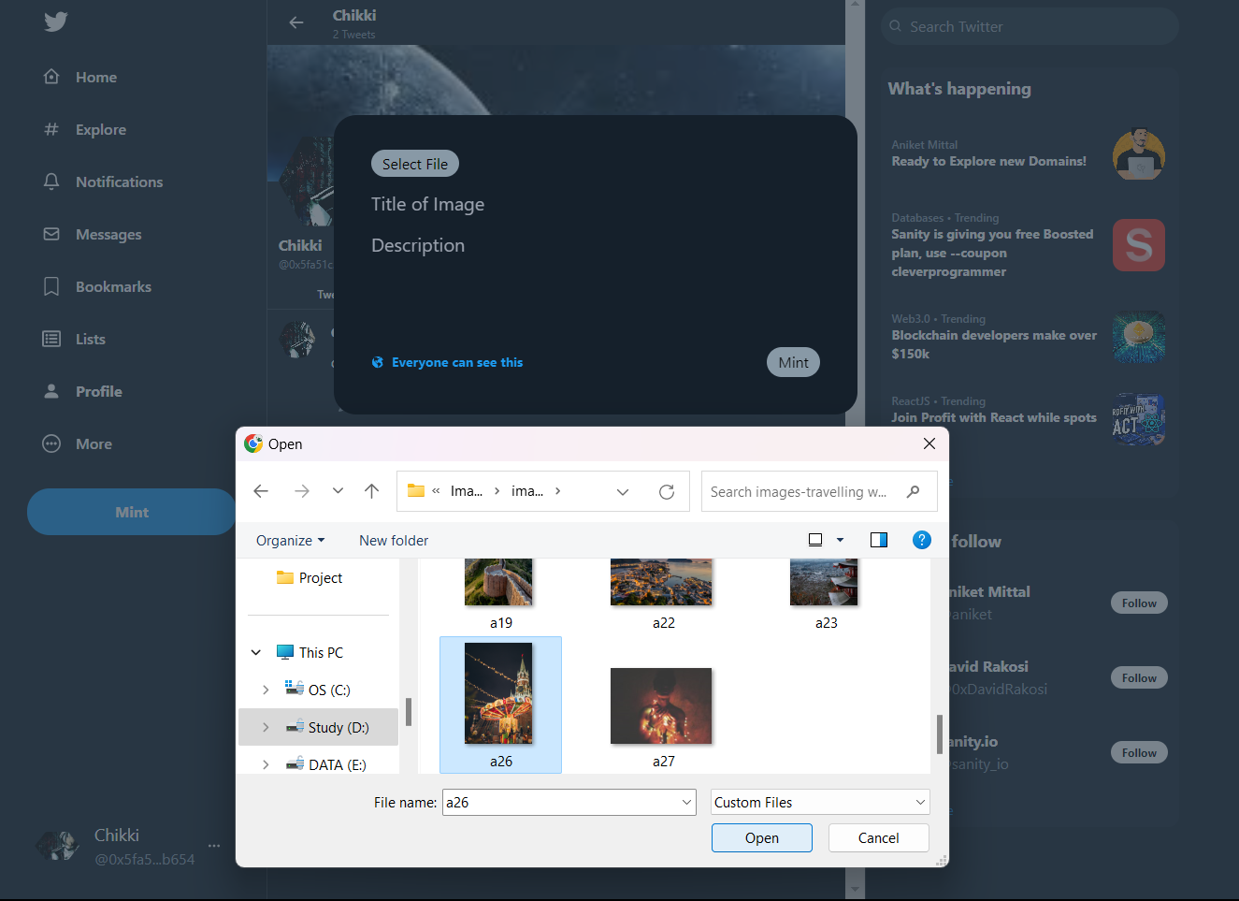
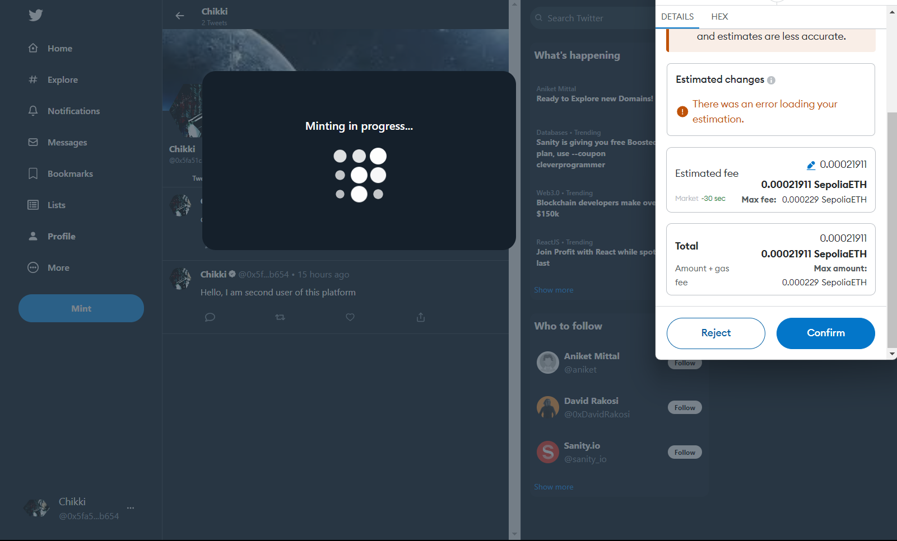
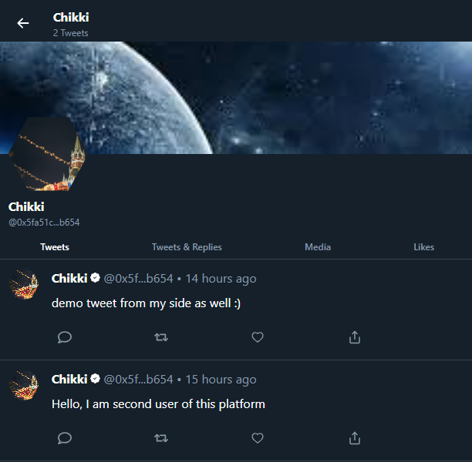
Results and Output Seamlessly Minting Profile Image NFTs
User-friendly interface simplifies NFT creation for even non-technical users.
MetaMask integration provides a secure and familiar wallet experience.
On-chain NFT clearly links the profile picture to the user's wallet address.

Slide 15
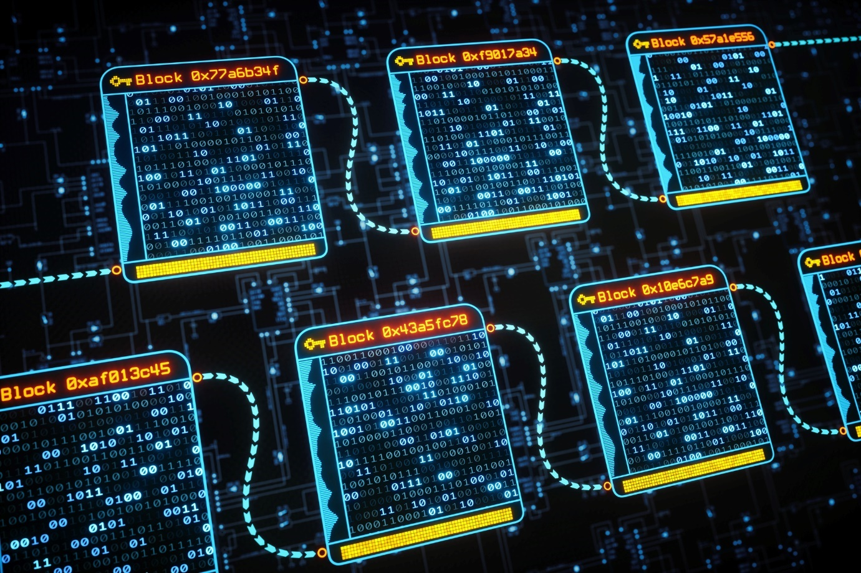
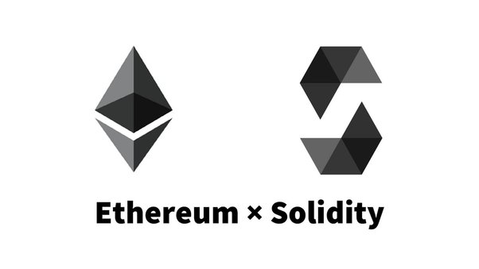
Building Blocks of a Decentralized Social Network
Smart contracts power NFT minting, enforcing ownership, and rules around profile pictures.
Core user data is stored within Sanity.io for efficient retrieval and content display.
Exploration of storing some content (text posts) or reputation metrics on-chain for censorship resistance.

Slide 16
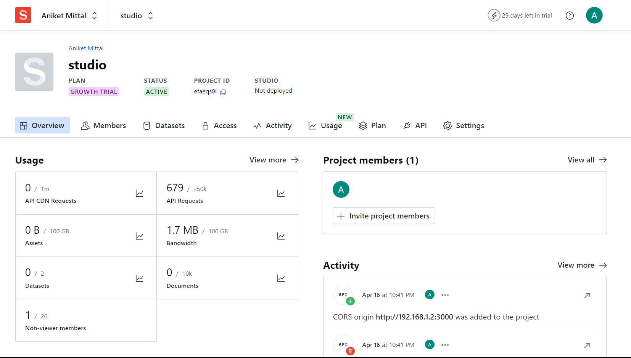
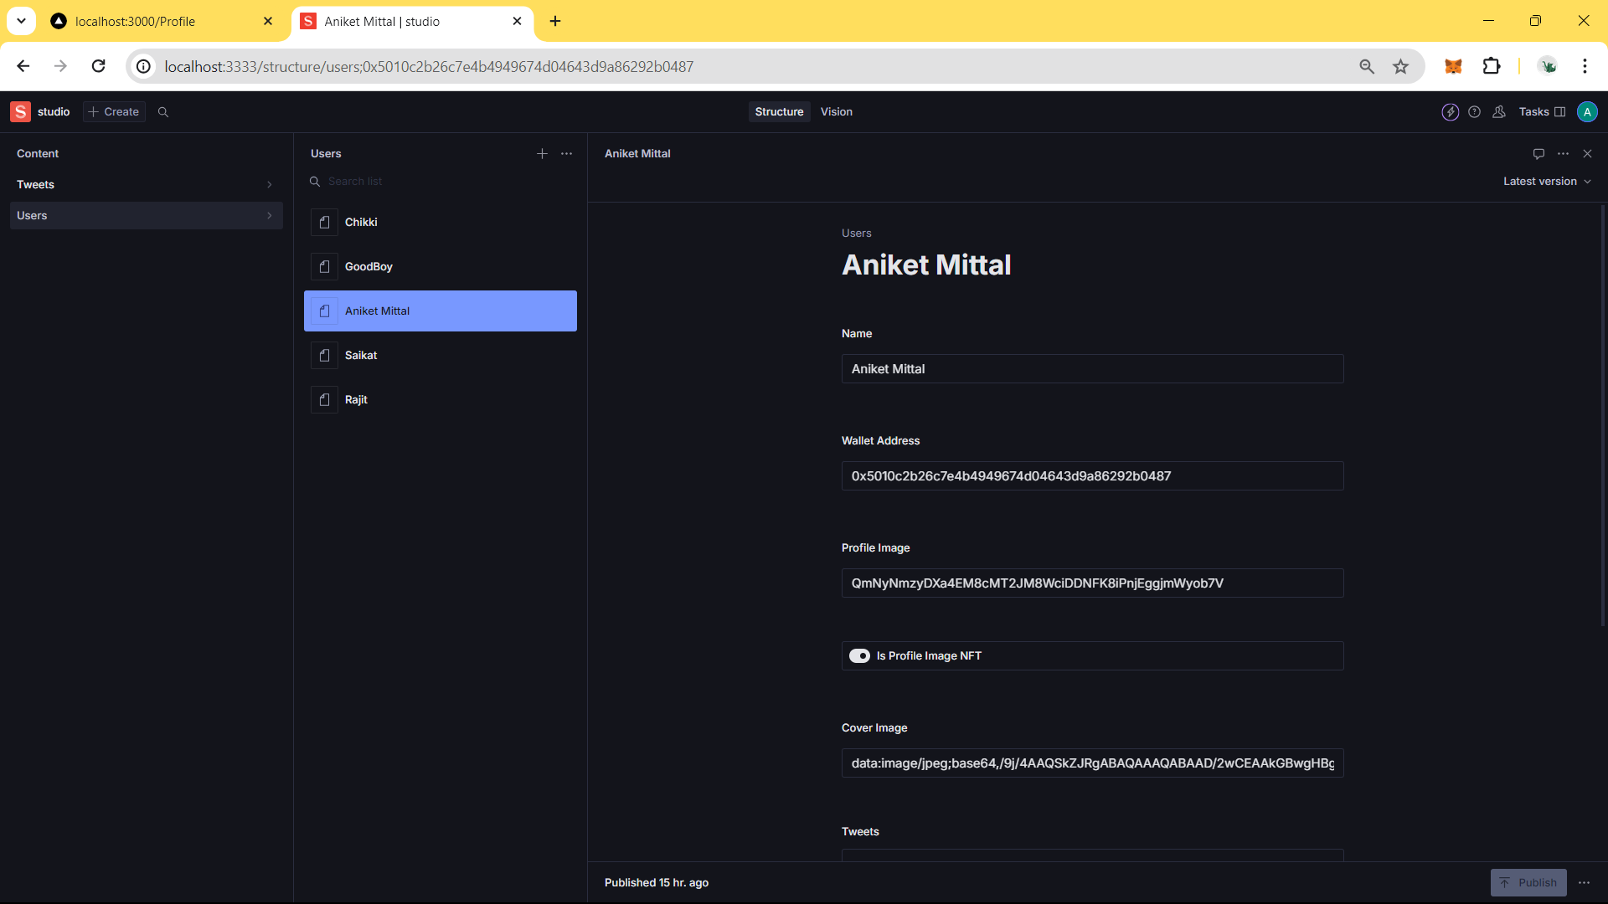
Early Traction and Community Formation
Smart contracts power NFT minting, enforcing ownership, and rules around profile pictures.
Core user data is stored within Sanity.io for efficient retrieval and content display.
Exploration of storing some content (text posts) or reputation metrics on-chain for censorship resistance.

Slide 17
CONCLUSION
Decentralized social media, as exemplified by my project, has the potential to disrupt traditional models, empowering users with greater control, privacy, and ownership. This prototype tackles core issues like censorship and data control, while fostering new economic models through NFTs. Early milestones, such as minting NFT’s, smart contract implementation, validate this project's potential for a more equitable and transparent social media future.

Slide 18
FUTURE WORK
Emphasize Transformation: Decentralized social media platforms have the potential to disrupt existing models, addressing power imbalances, and giving users greater agency.
Solving Real Problems: Remind the audience of the core problems your project tackled: censorship resistance, data ownership, potential for new economic models (via tokens or NFTs).
Early Successes: Summarize key achievements from your "Results" section. Number of users, unique features, or positive feedback are all valid here.

Slide 19
REFERENCES
[1] Y. Chen, Y. Zhu, and G. Xu, "Social Media User Privacy Protection: A Survey," IEEE Transactions on Computational Social Systems, vol. 10, no. 1, pp. 77-89, Feb. 2023. doi: 10.1109/TCSS.2022.3229833
[2] S. Vaidhyanathan, Antisocial Media: How Facebook Disconnects Us and Undermines Democracy, New York: Oxford University Press, 2018.
[3] D. Y. Jin, "Transforming the Social: Technology, Content, and Power in the Creator Economy", International Journal of Cultural Studies, vol. 24 no. 5, pp. 787-804, Sept 2021. doi: 10.1177/1367877920982786
[4] Berners-Lee, T. (1989). Information Management: A Proposal. CERN. [Online]. Available: http://www.w3.org/History/1989/proposal.html
[5] Chen, Y., Zhu, Y., and Xu, G. (2023). "Social Media User Privacy Protection: A Survey," IEEE Transactions on Computational Social Systems, vol. 10, no. 1, pp. 77-89, Feb. 2023. doi: 10.1109/TCSS.2022.3229833
[6] Chohan, U. W. (2021). The Decentralized Web 3.0 Revolution: The Blockchain, Cryptocurrencies, NFTs, Metaverse, Web3 and how it will disrupt every industry from Finance to Gaming.
[7] De Filippi, P., & McMullen, G. (2018). Governance of Blockchain Systems: Communities, Institutions and Technology. MIT Press.

Slide 20
[8] Hendler, J. (2001). Agents and the Semantic Web. IEEE Intelligent Systems, vol. 16, no.2, pp. 30–37. doi: 10.1109/5254.920597
[9] Miller, H., Thebault-Spieker, J., Chang, S. et al. (2022). Explainer: Web3, a Vision for a Decentralized Internet. Stanford Graduate School of Business.
[10] Vaidhyanathan, S. (2018). Antisocial Media: How Facebook Disconnects Us and Undermines Democracy. Oxford University Press.
[11] Y. Chen, Y. Zhu, and G. Xu, "Social Media User Privacy Protection: A Survey," IEEE Transactions on Computational Social Systems, vol. 10, no. 1, pp. 77-89, Feb. 2023. doi: 10.1109/TCSS.2022.3229833
[12] S. Vaidhyanathan, Antisocial Media: How Facebook Disconnects Us and Undermines Democracy, New York: Oxford University Press, 2018.
[13] D. Y. Jin, "Transforming the Social: Technology, Content, and Power in the Creator Economy", International Journal of Cultural Studies, vol. 24 no. 5, pp. 787-804, Sept 2021. doi: 10.1177/1367877920982786
[14] P. De Filippi, & G. McMullen, Governance of Blockchain Systems: Communities, Institutions and Technology. MIT Press, 2018.
[15] U. W. Chohan, The Decentralized Web 3.0 Revolution: The Blockchain, Cryptocurrencies, NFTs, Metaverse, Web3 and how it will disrupt every industry from Finance to Gaming. [Online]. Available: https://www.amazon.com/Web3-Decentralized-Contracts-Decentralization-Blockchain/dp/B09JDYKND7

Slide 21
[16] H. Miller, J. Thebault-Spieker, S. Chang et al. "Explainer: Web3, a Vision for a Decentralized Internet." Stanford Graduate School of Business. [Online]. Available: https://hbr.org/2023/09/web3-could-change-the-business-model-of-creative-work
[17] Kopyto, M., & Bulut, E. (2021). SteemIt: Analysis of User Behavior and Evaluation of the Influence Mechanism. Computer and Information Sciences, 142, 161–176. doi.org/10.1007/978-3-030-89092-0_13
[18] Chohan, U. W. (2021). The Decentralized Web 3.0 Revolution: The Blockchain, Cryptocurrencies, NFTs, Metaverse, Web3 and how it will disrupt every industry from Finance to Gaming.
[19] De Filippi, P., & McMullen, G. (2018). Governance of Blockchain Systems: Communities, Institutions and Technology. MIT Press.
[20] Miller, H., Thebault-Spieker, J., Chang, S. et al. (2022). Explainer: Web3, a Vision for a Decentralized Internet. Stanford Graduate School of Business.
[21] Lo, S. K., Xu, X., Staples, M. L., Yao, L., & Nguyen, L. (2021). A blockchain-based layered security architecture for intelligent healthcare systems. Computers & Electrical Engineering, 94, 107337. doi.org/10.1016/j.compeleceng.2021.107337
[22] Park, J., Park, S., & Park, Y. (2023). Exploring the usability of blockchain-based cryptocurrency wallets. PLoS ONE, 18(2), e0281791. doi:10.1371/journal.pone.0281791
[23] S. Nakamoto, “Bitcoin: A Peer-to-Peer Electronic Cash System,” 2008. [Online]. Available: https://bitcoin.org/bitcoin.pdf

